Slide 1
Building AI Application Challenge
Done by: Samer Rihawi

Slide 2
Challenge Details
I participated in this challenge to gain knowledge about AI and how it can be used to build different types of applications
I chose the Low Code/No Code track as it is considered as one of the most trending technologies today
It can help to build different types of applications by people with a little knowledge or even little knowledge in programming
As a developer, it can save my time by easily using templates and tools without minimal coding efforts

Slide 3
My Application (AI Tutor)
The idea of my application is to build an AI tutor app that can help students by answering their questions by selecting the subject of their choice (Math, History, Geography,..etc)
Then the student can type his/her question, and the App will display the answer
The App was built using Bubble.io as a Low Code/No Code platform and integrated with OpenAI API

Slide 4
Development phases
Building the UI
Integration with OpenAI
Executing the Events
Deploying the App

Slide 5
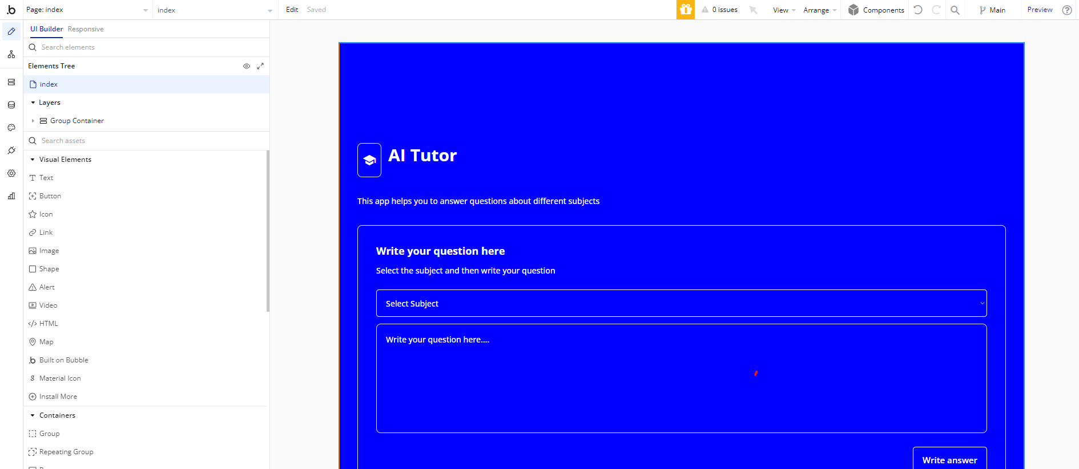
Building AI
Bubble.io has different visual elements which can be added by simply dragging and dropping them in the main UI
This can save time coding each visual elements

Slide 6
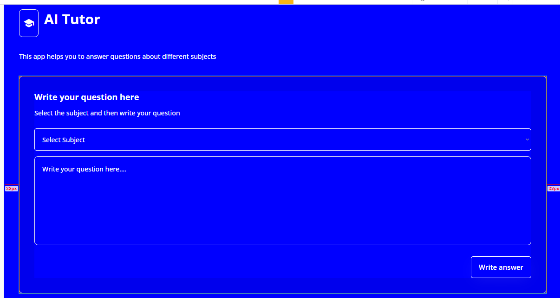
Input UI
The purpose of this UI is to receive the input from the user
There are two inputs
Subject
Question
Then the user can click on Write answer so that the App can generate the answer

Slide 7


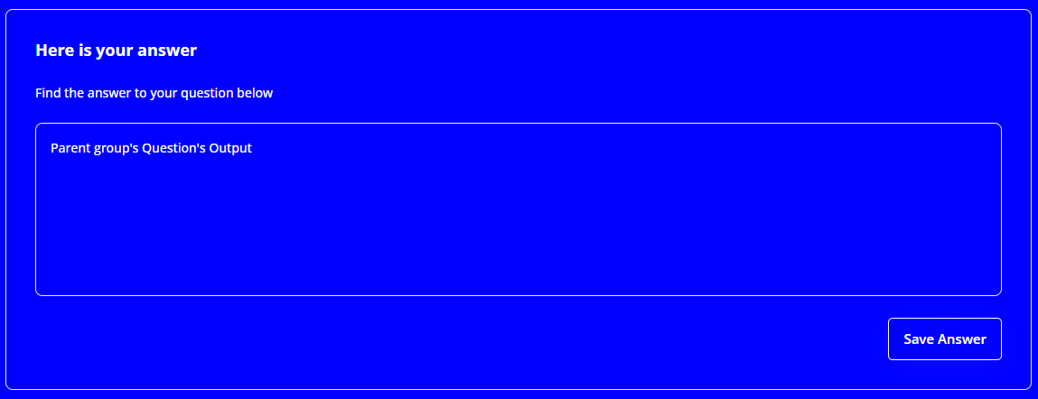
Output UI
There are three types of Output
Idle: Displayed when the App is waiting for an input from the user
Pending: Displayed when the App is in the process of generating the output
Results: Displaying the answers

Slide 8
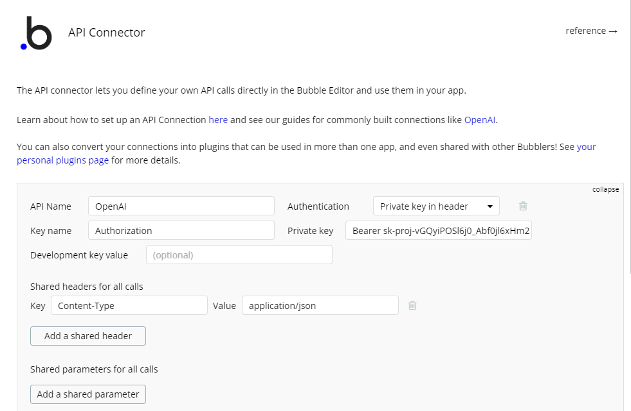
Integration with OpenAI
Bubble can connect with OpenAI using Plugins which allow it to integrate with different APIs

Slide 9
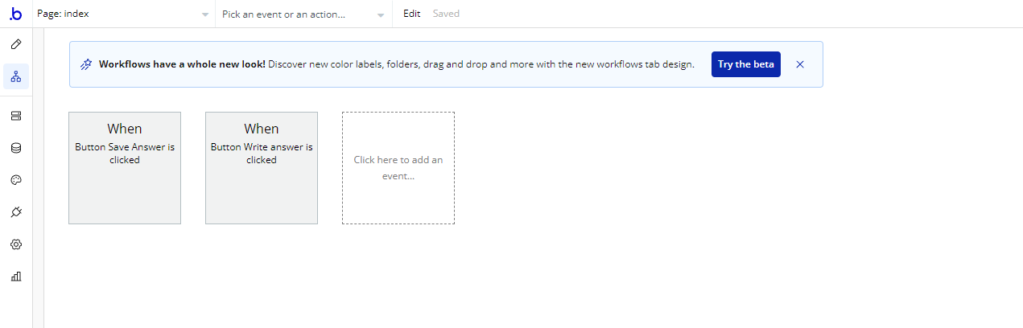
Executing Events
Bubble uses Workflows for executing events instead of coding them
There are two types of events
When Write Answer is Clicked
When Save Answer is Clicked

Slide 10
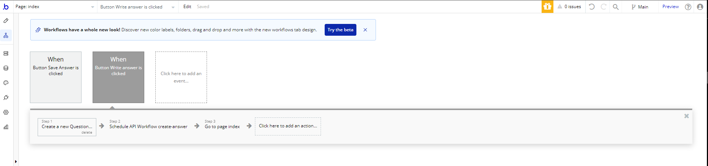
Write Answer Event
There are three phases:
Creating a new question
Integrating with OpenAI API to build an answer
Returning to the Home Page

Slide 11
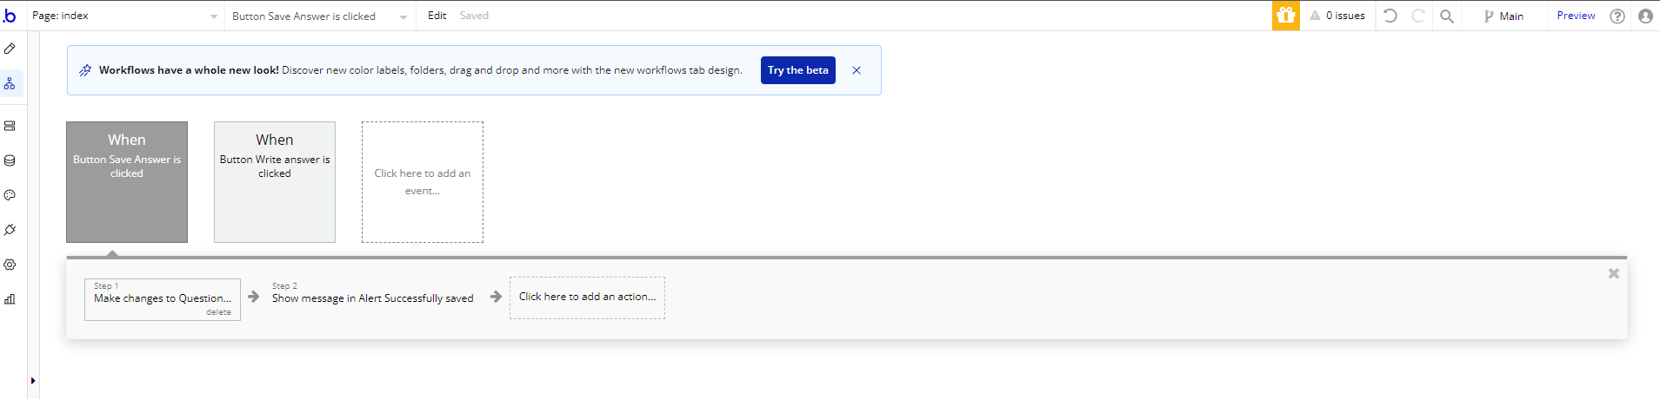
Save Answer Event
There are three two phases
Adding the question and answer to the App database
Showing a message that the answer is successfully saved

Slide 12
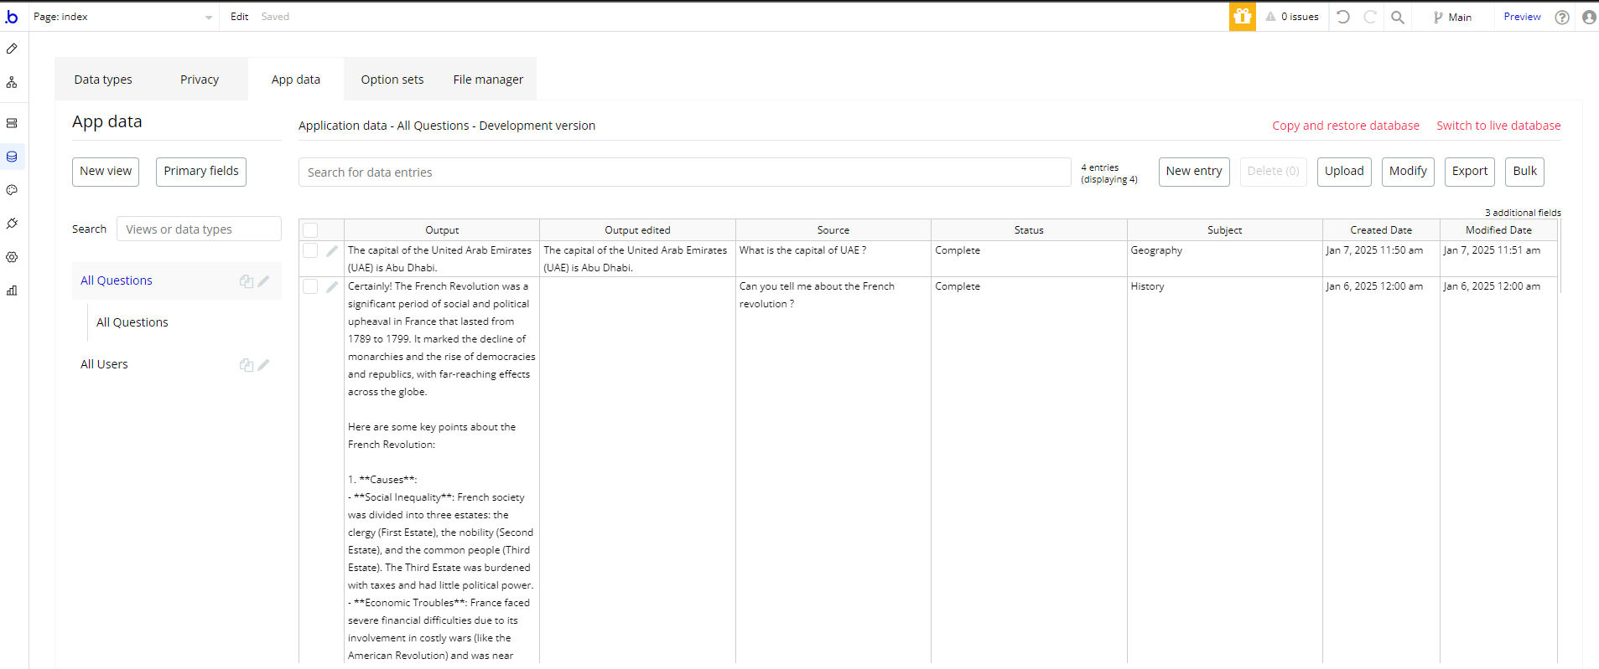
Answers Database
The App saves the questions and answers in a separate database for recoding purposes

Slide 13
Conclusion
This AI challenge presented me with a unique opportunity to learn about Low Code/No Code and how it can be used in building different types of Apps with minimal efforts.
Hopefully it will help me to enhance my knowledge by using other types of Low Code/No Code in different projects.

